Slide 1
Culturally Relevant Teaching and Learning Engagement
Elizabeth Perry

Slide 2
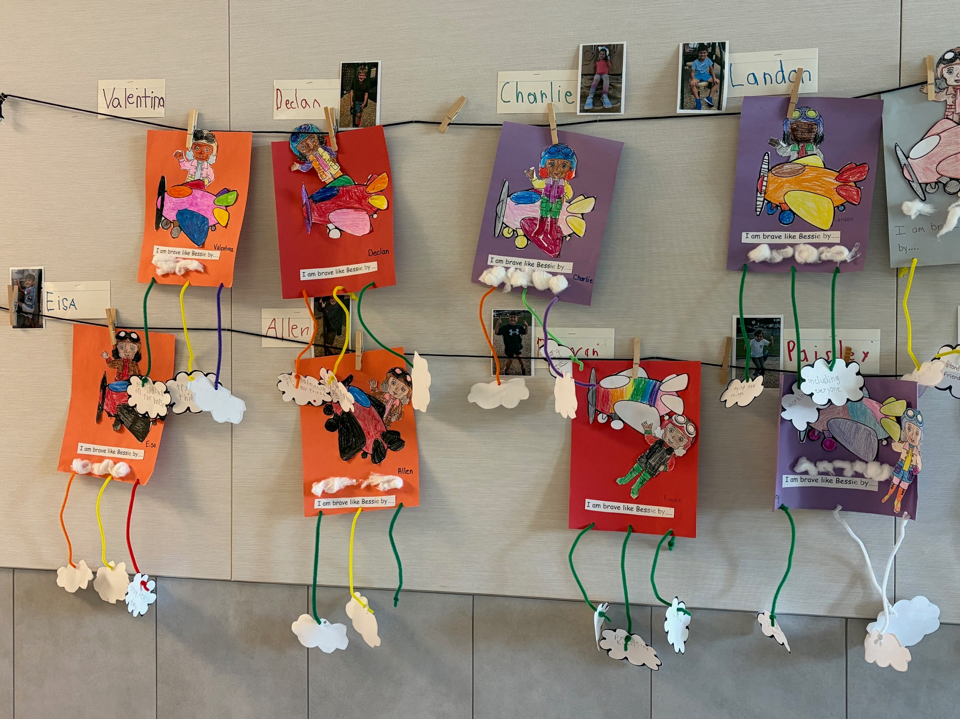
Bessie Coleman
While student teaching I taught a lesson on the pioneer African American women pilot, Bessie Coleman. Our lesson was during Black history month. We learned about courage and ways the students showcase courage.

Slide 3
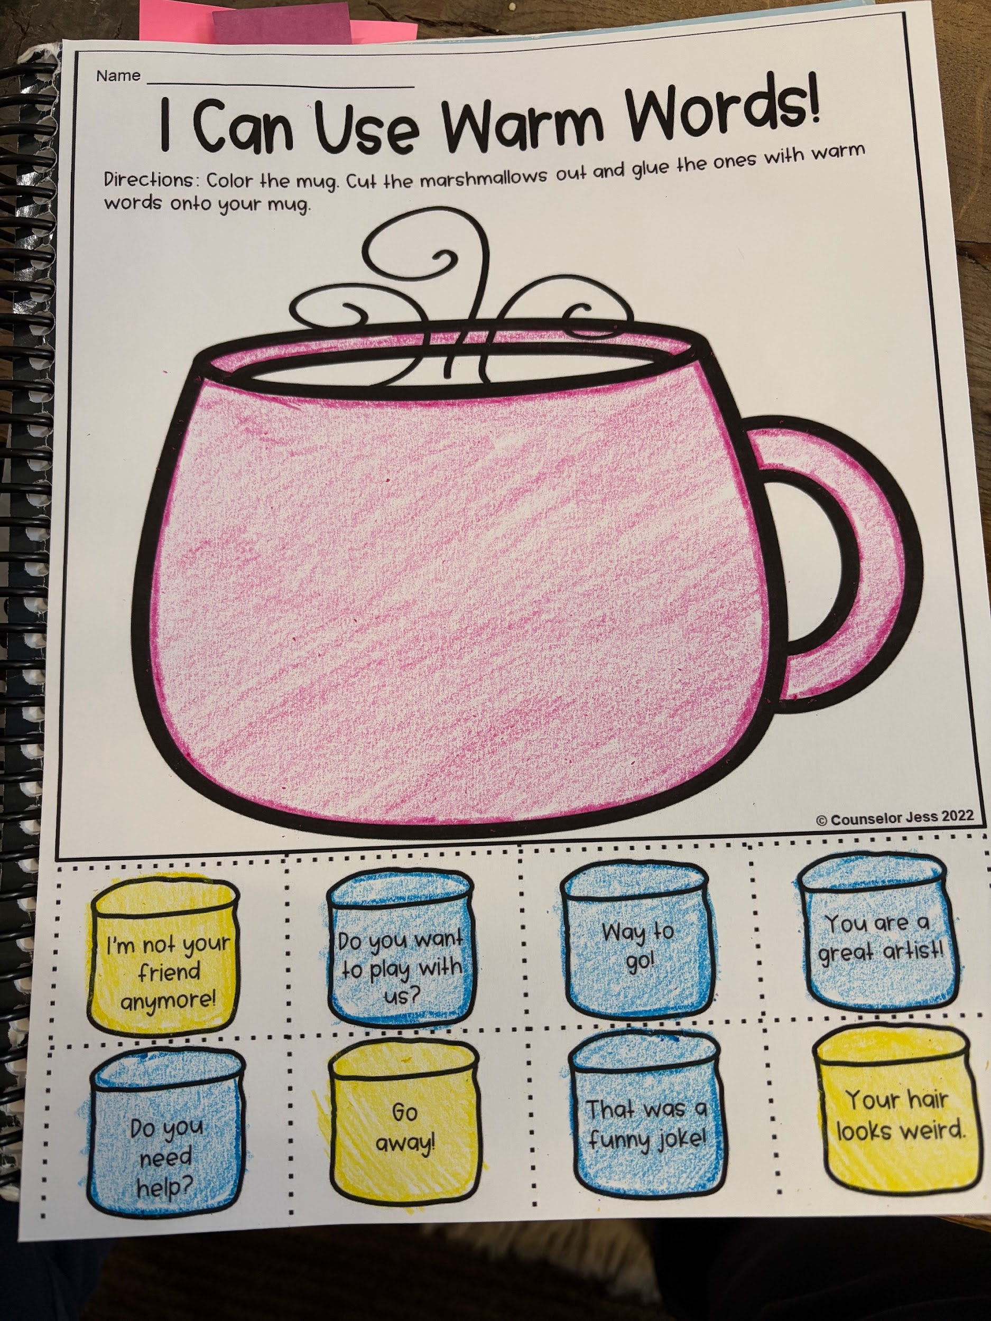
What is empathy?
Empathy was a big lesson we learned in school this past semester. I read out loud, Empathy is my super power and we did an activity with “warm” and “cold” words.

Slide 4
Special Education Philosophy Paper
https://docs.google.com/document/d/16xJZAfHpXZIuxOWrcMqSIEwemahwJxcE/edit?usp=sharing&ouid=108005916222617989639&rtpof=true&sd=true

Slide 5
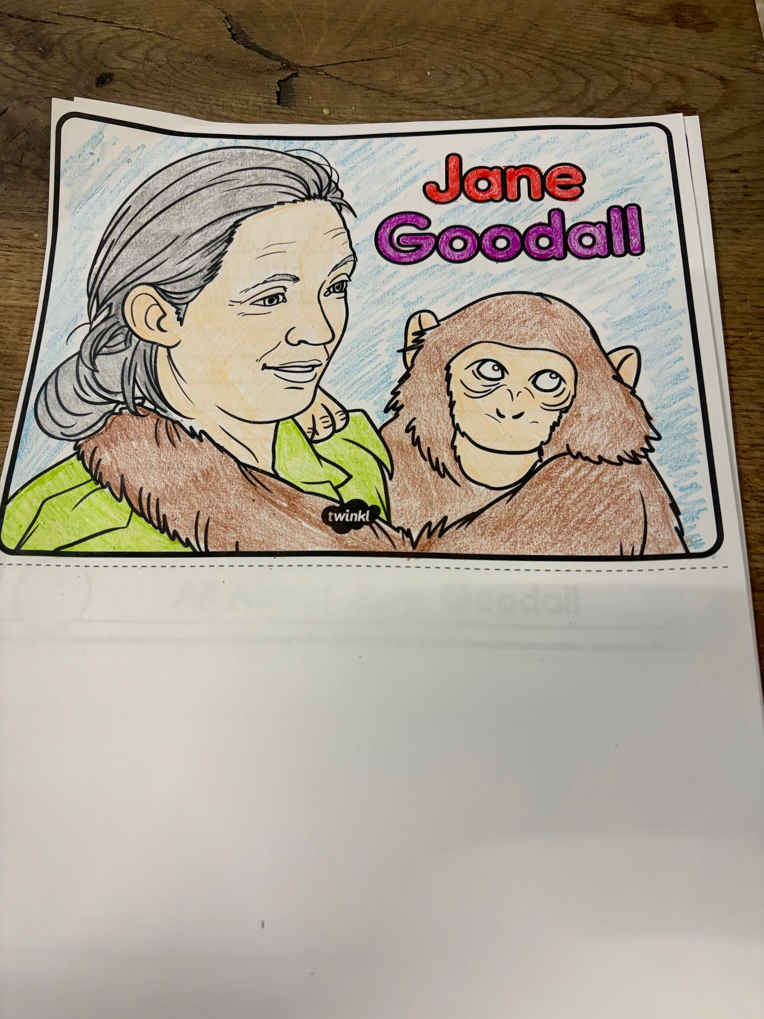
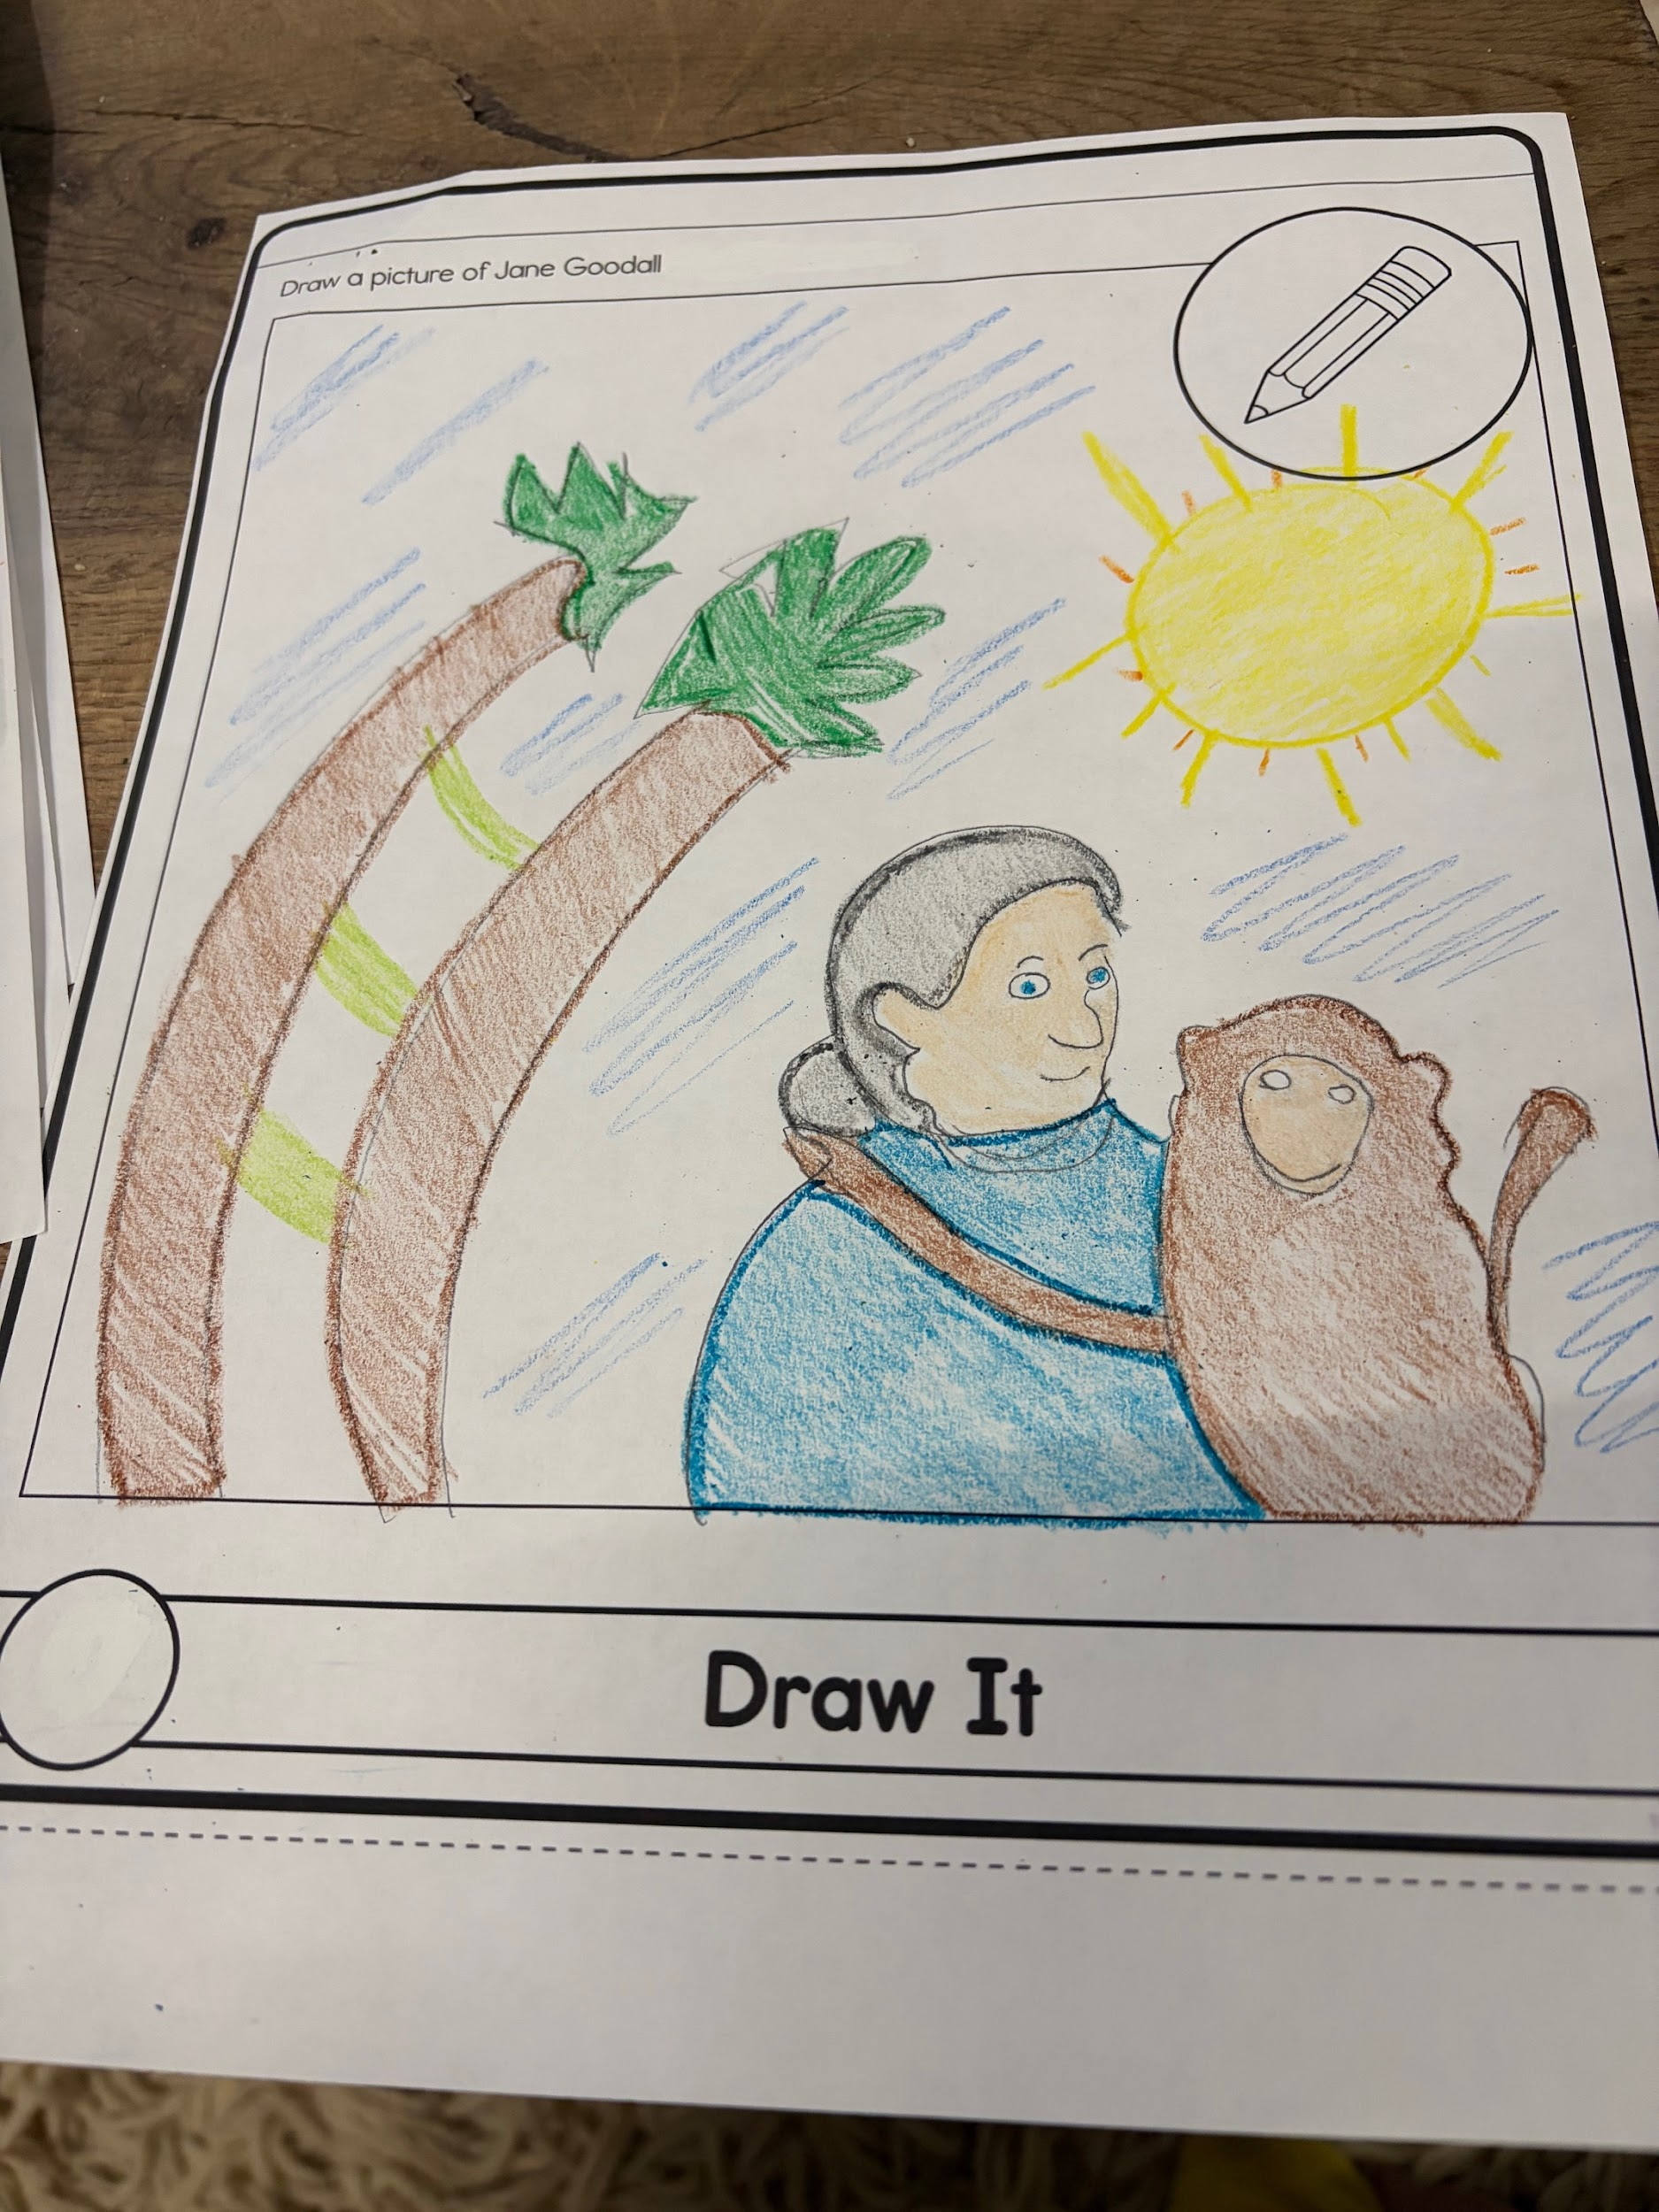
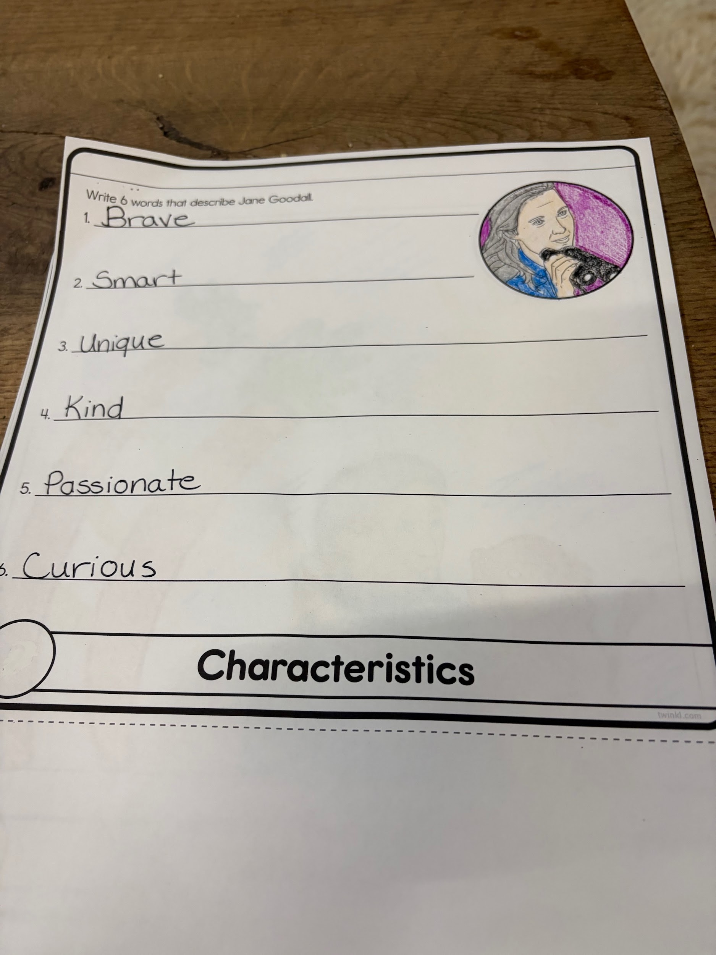
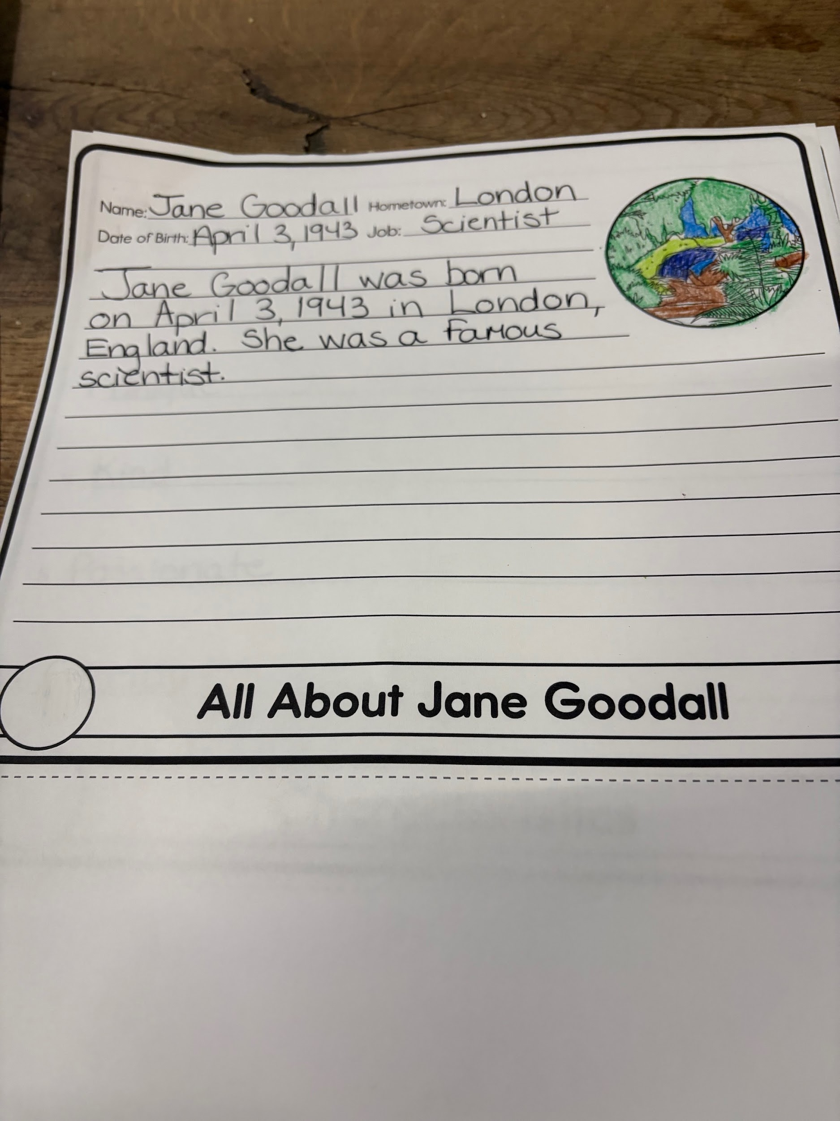
Incredible Pioneers
Women’s Month I taught a lesson about the phenomenal Jane Godall using a flip book.

Slide 6
In spring of 2024 I had the opportunity to learn more about the indigenous individuals from Canada who had neurodiversity differences. This article speaks of the struggles of their people and the hope that these conferences ignite. It evaluates the impact of incorporating traditional teaching and medicines within educational, social and health related programs
Article: https://theconversation.com/hearing-the-voices-of-indigenous-people-with-neurodevelopmental-disabilities-218566
https://youtu.be/Fxv1za8arlw?si=w35yRc1su-BFcmOn .

Slide 7
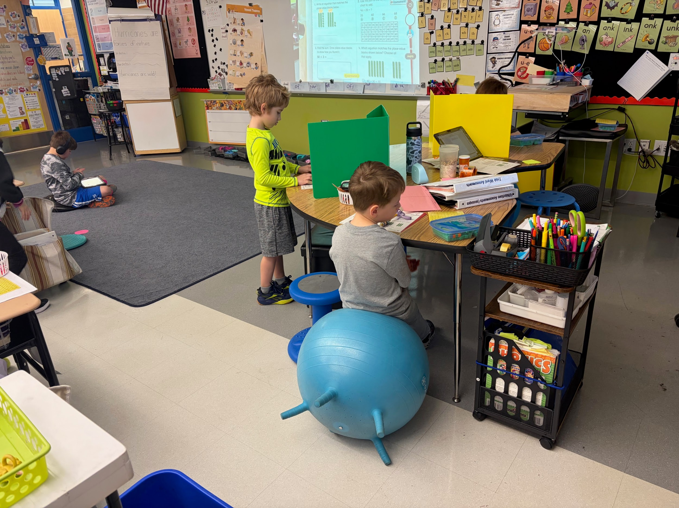
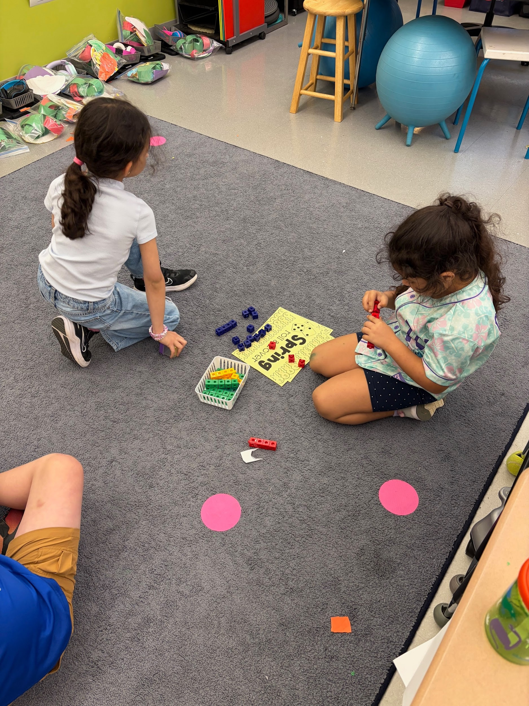
Strategies for Independent Learners
https://canva.link/02jd1blr6myv8yb

Slide 8
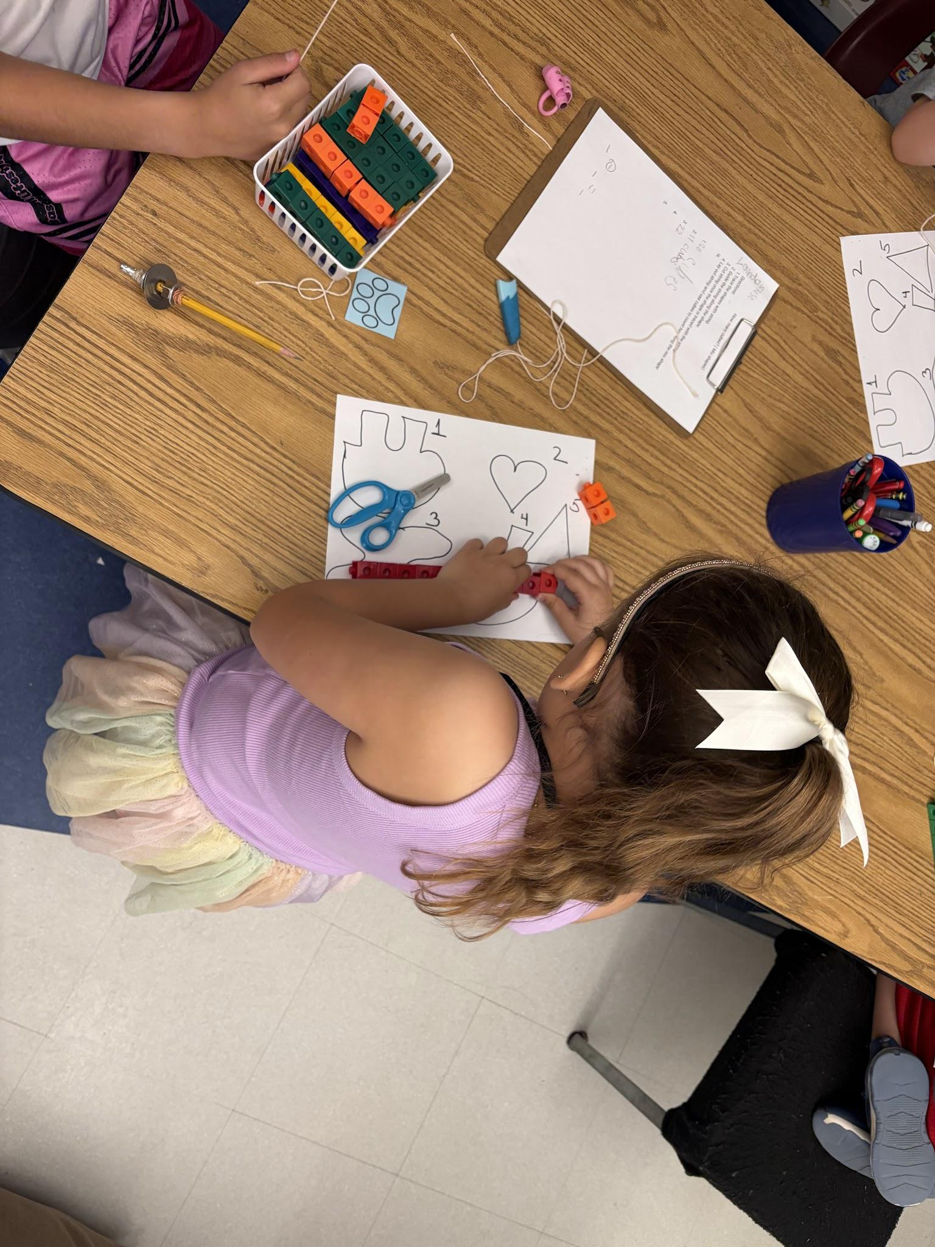
Maria
https://docs.google.com/document/d/1U1rBCndKp_eRgWhEB1O6_dAvgX3c8lj1/edit?usp=sharing&ouid=108005916222617989639&rtpof=true&sd=true

Slide 9
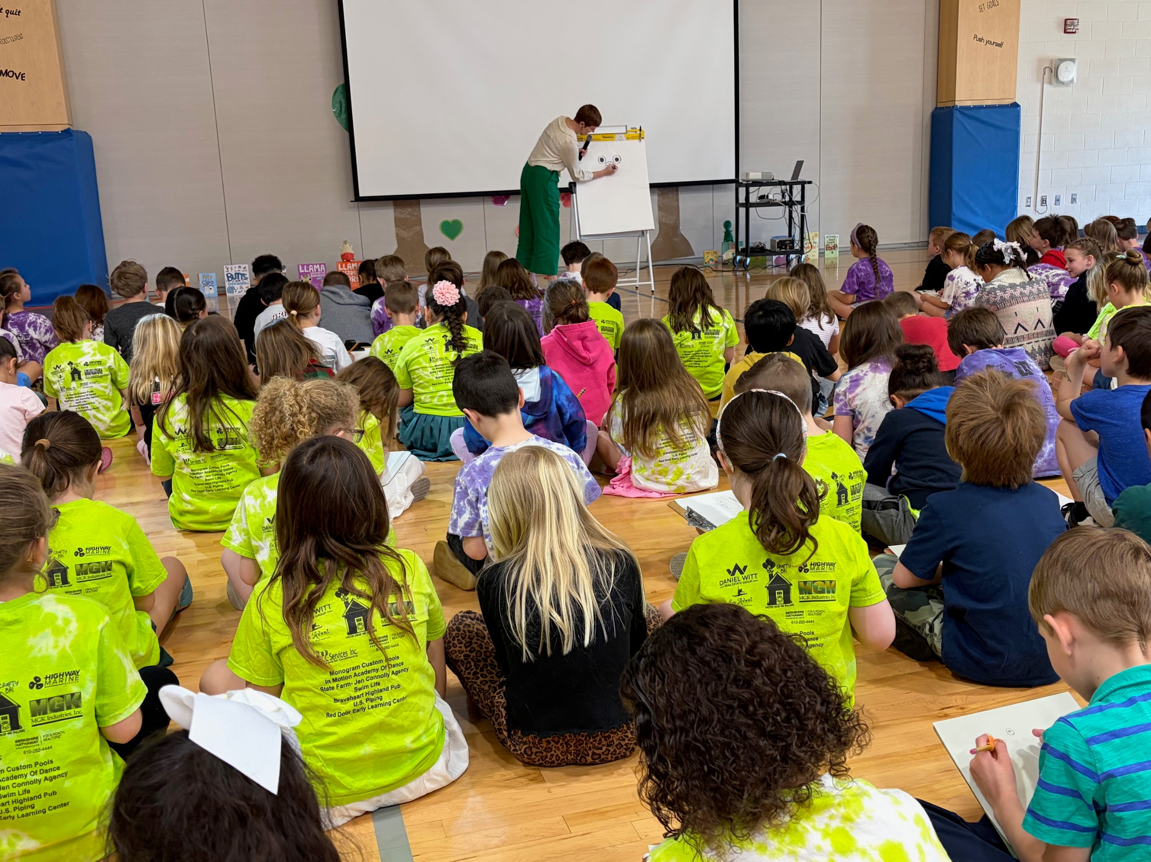
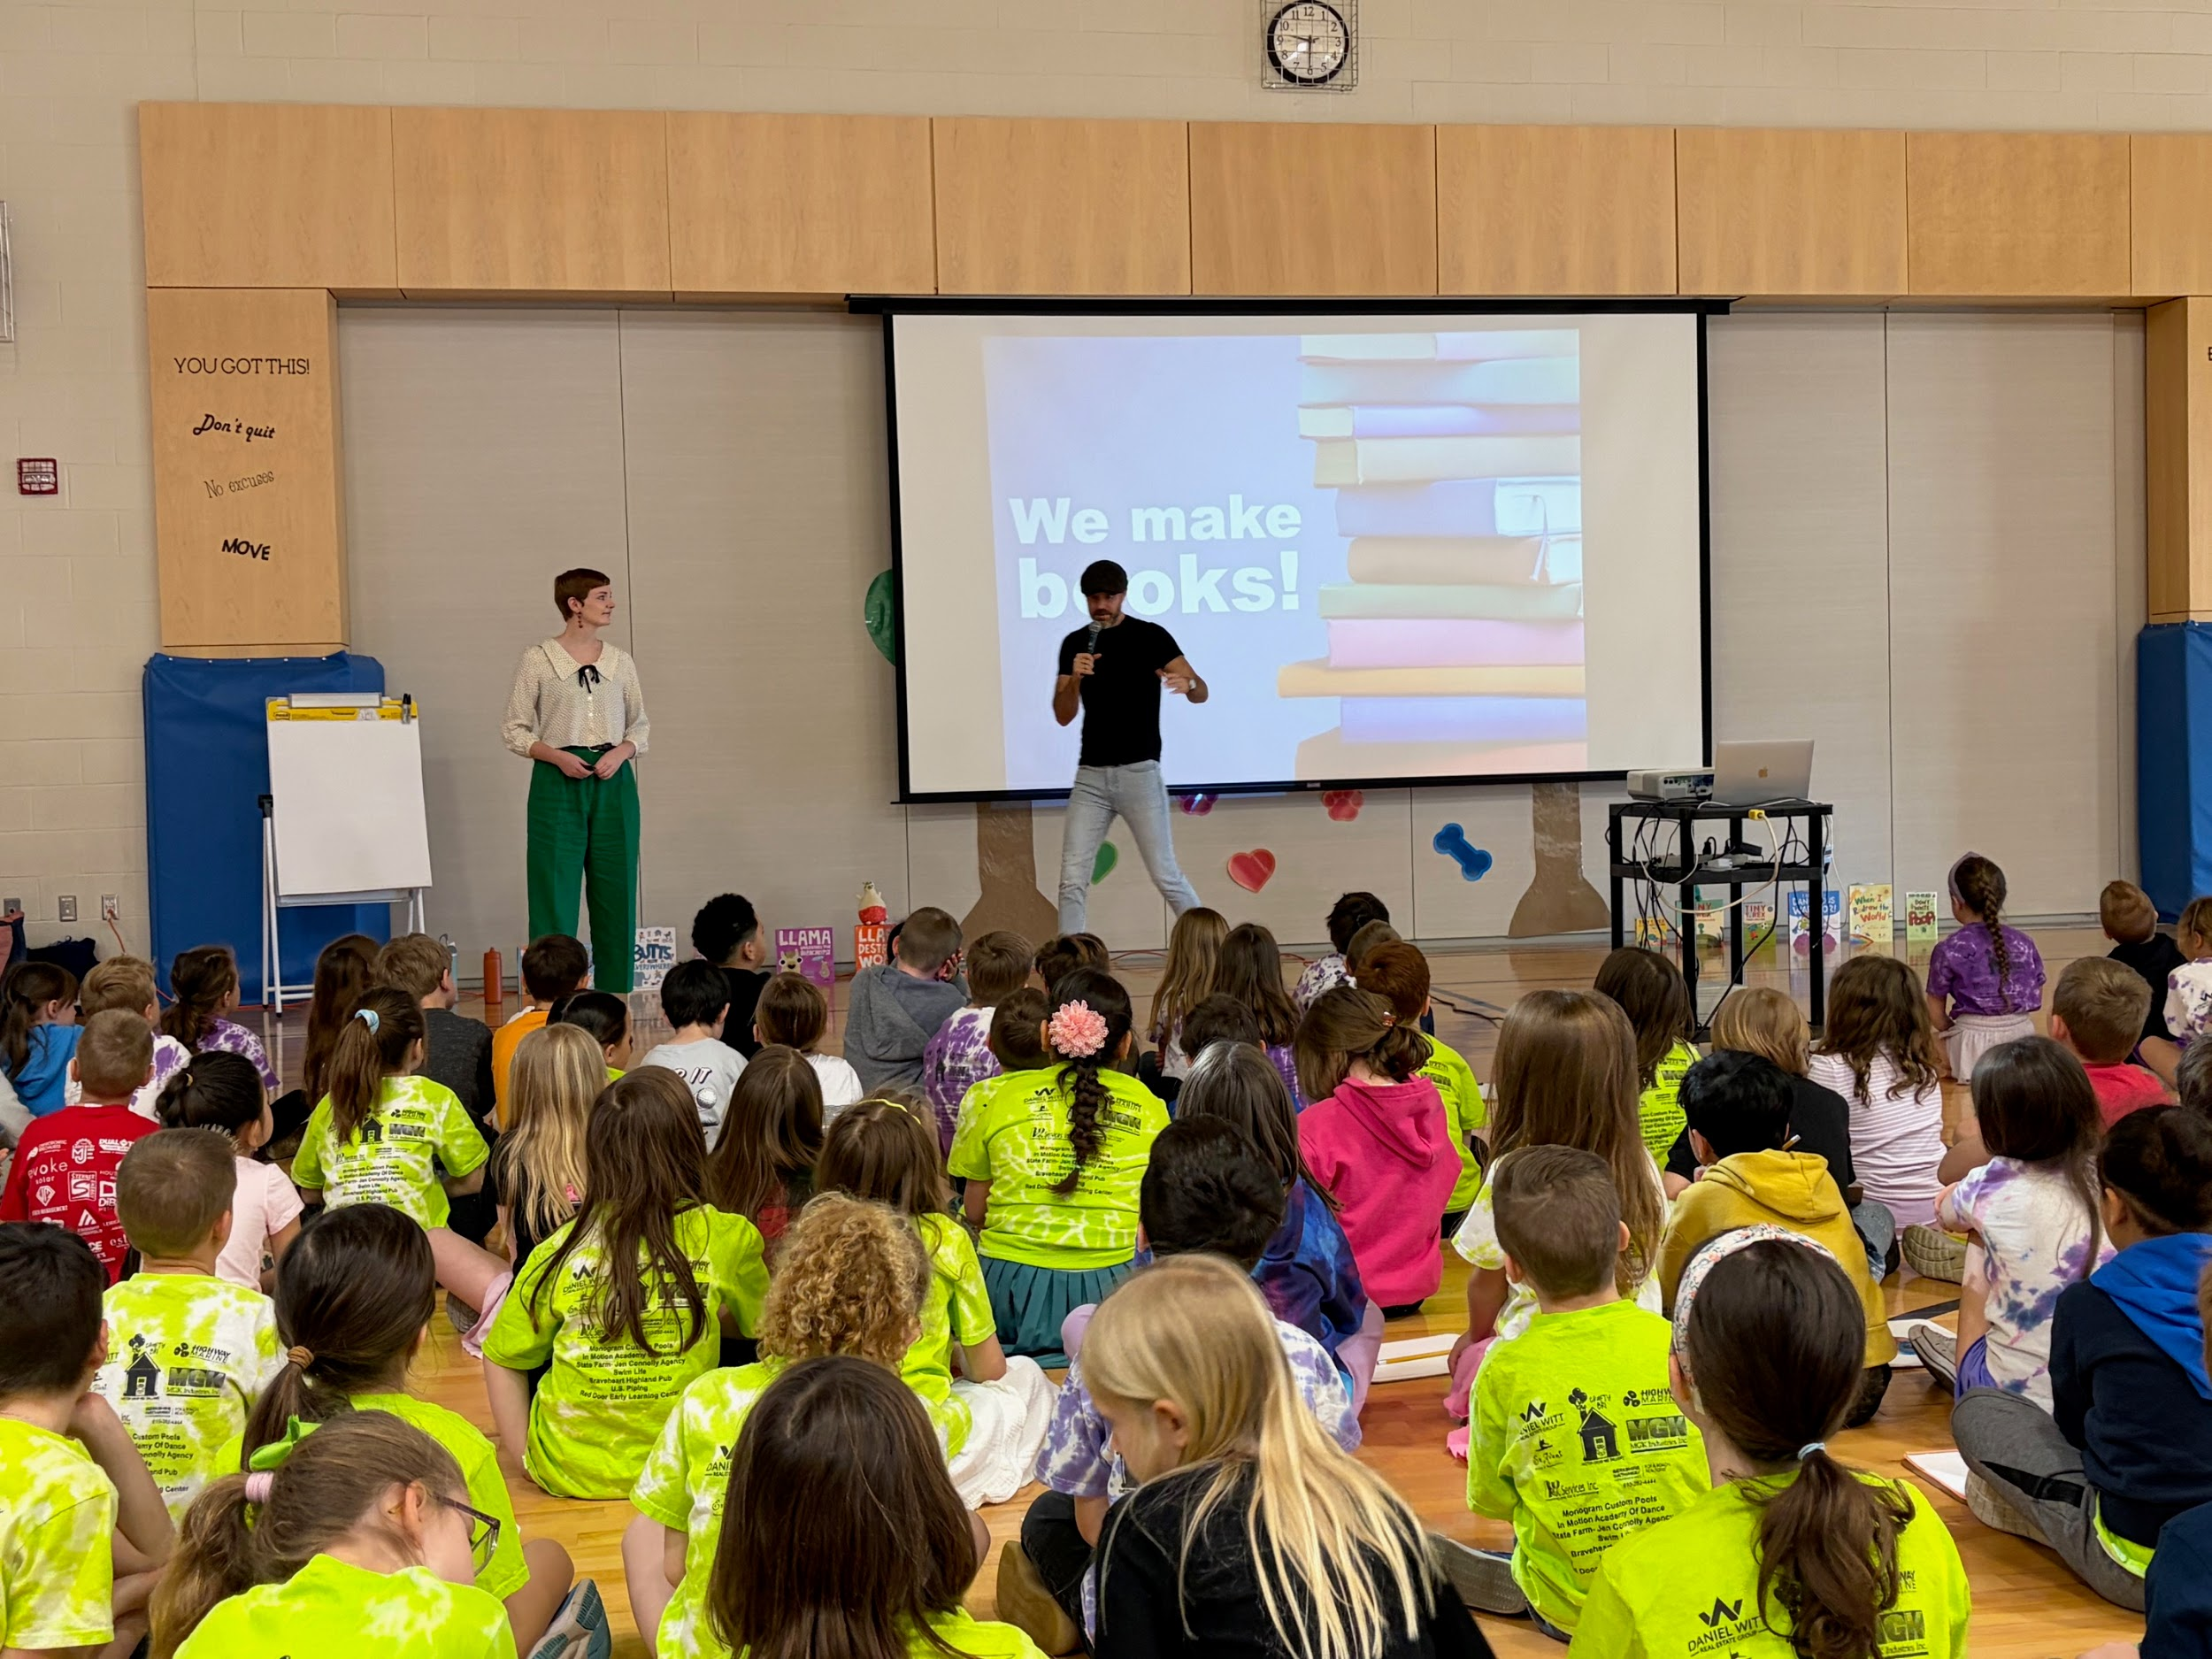
Read Across America (Author Visit)

Slide 10
Native American Culture
In fall of 2025 I was a part of a group project about the Native American culture. In our class we learned about many different cultures and the importance of getting to know our students. When we have a better understanding of our students we can be better educators.
https://canva.link/coavieyxnkb9k21

Slide 11
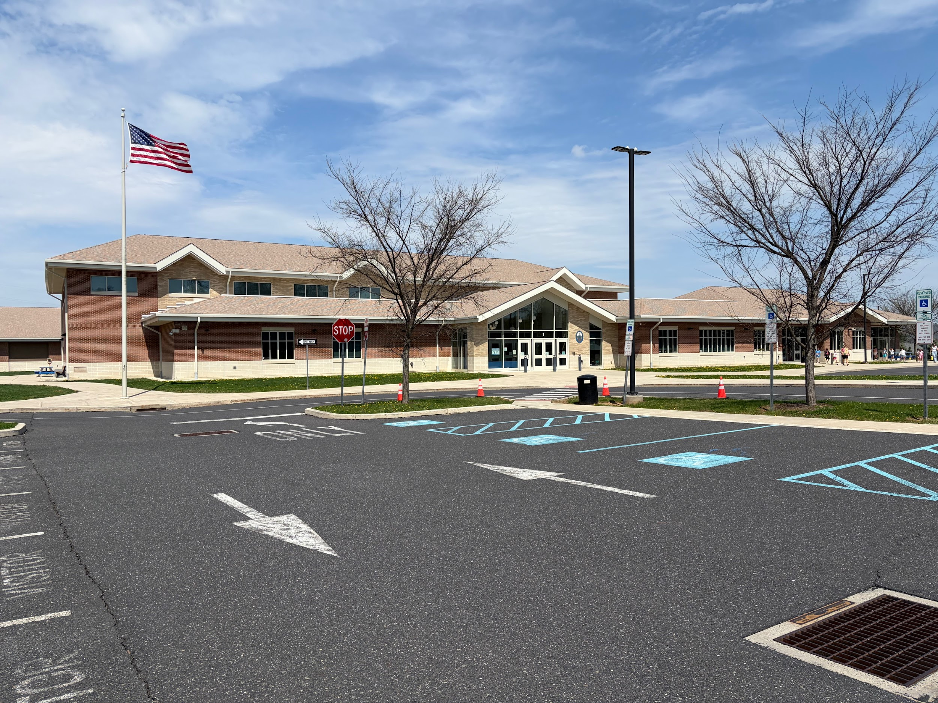
Cyber Bullying/ Violence in Schools
https://canva.link/as3cunqturtk7wq

Slide 12
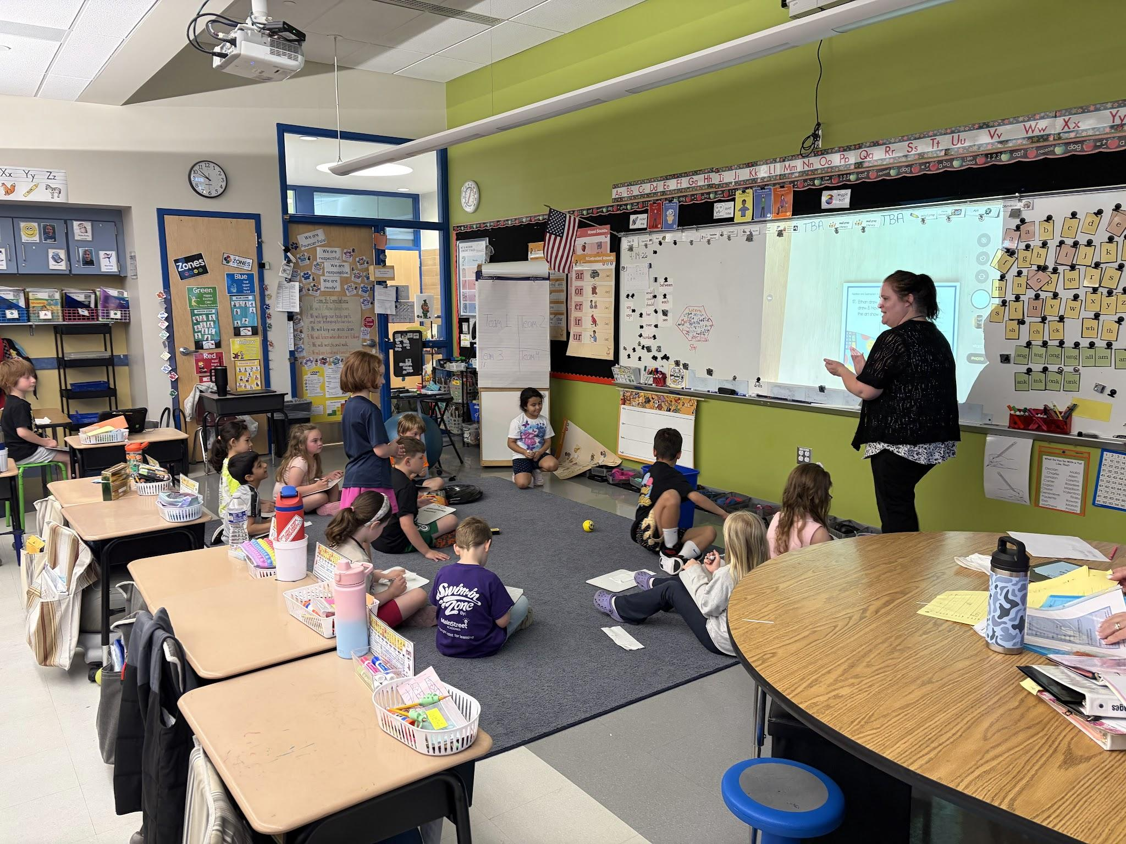
Structured Literacy
https://docs.google.com/document/d/1K8WxeLN-s23Txlb1vu0KiNs4GvQyV-DI/edit?usp=sharing&ouid=108005916222617989639&rtpof=true&sd=true

Slide 13
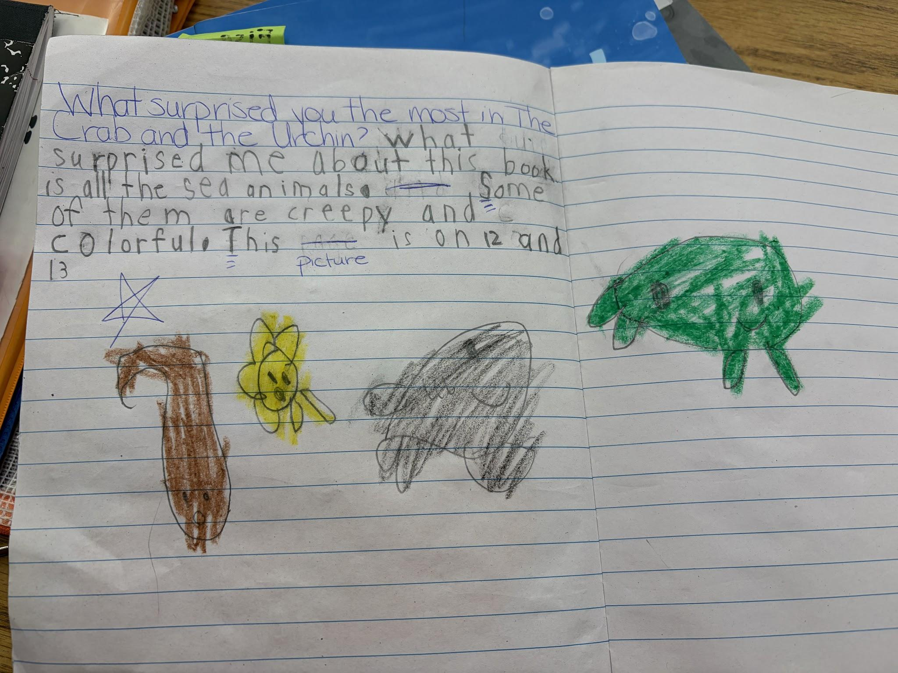
Poverty and Mental Health Crisis in Education
https://docs.google.com/document/d/17WGeAJxWxIIP6bsTYzIzKRvI0Ouj70aY/edit?usp=sharing&ouid=108005916222617989639&rtpof=true&sd=true
:

Slide 14
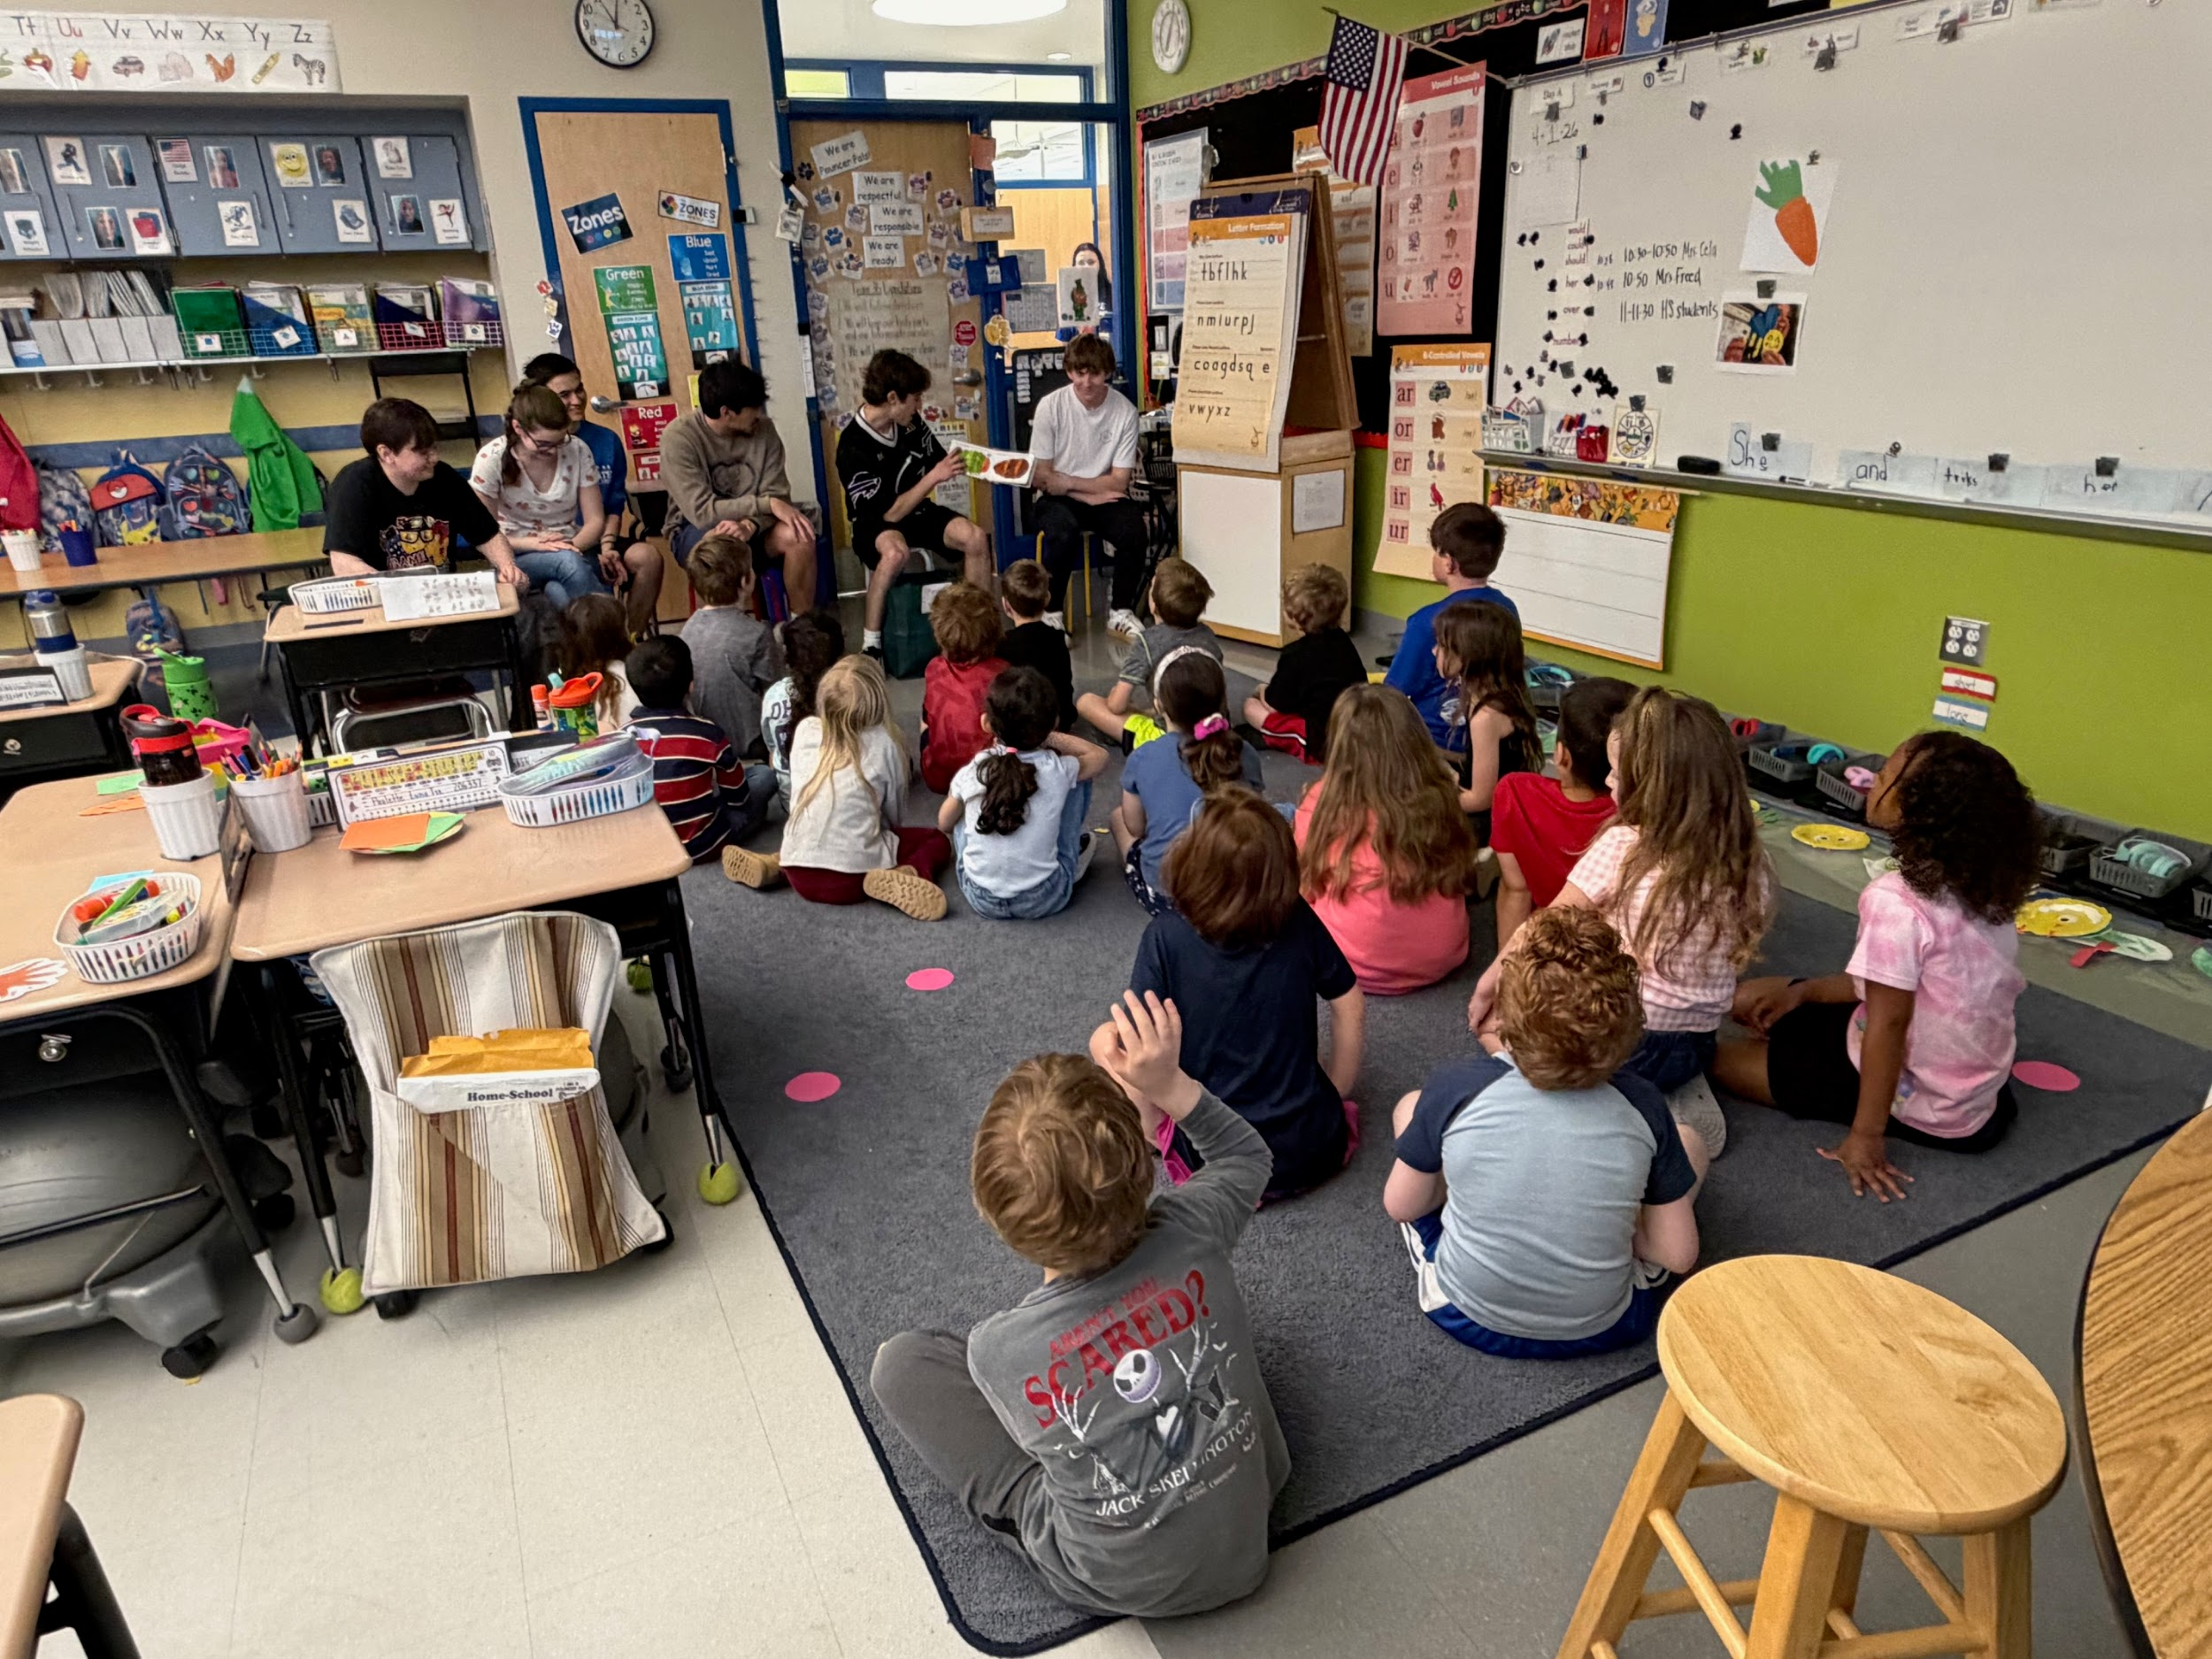
Individuals with Learning Differences
https://canva.link/wncdfw6qqpn92b5

